Slide 1

EXTERN + OUTAMATION
EXTERNSHIP
ADVANCED AI-POWERED
DOCUMENT INSIGHT AND DATA EXTRACTION
PROJECT
SPRINT 1 STATUS UPDATE
by Lashawn Fofung, MBA, PMP, CSM, CSPO

Slide 2
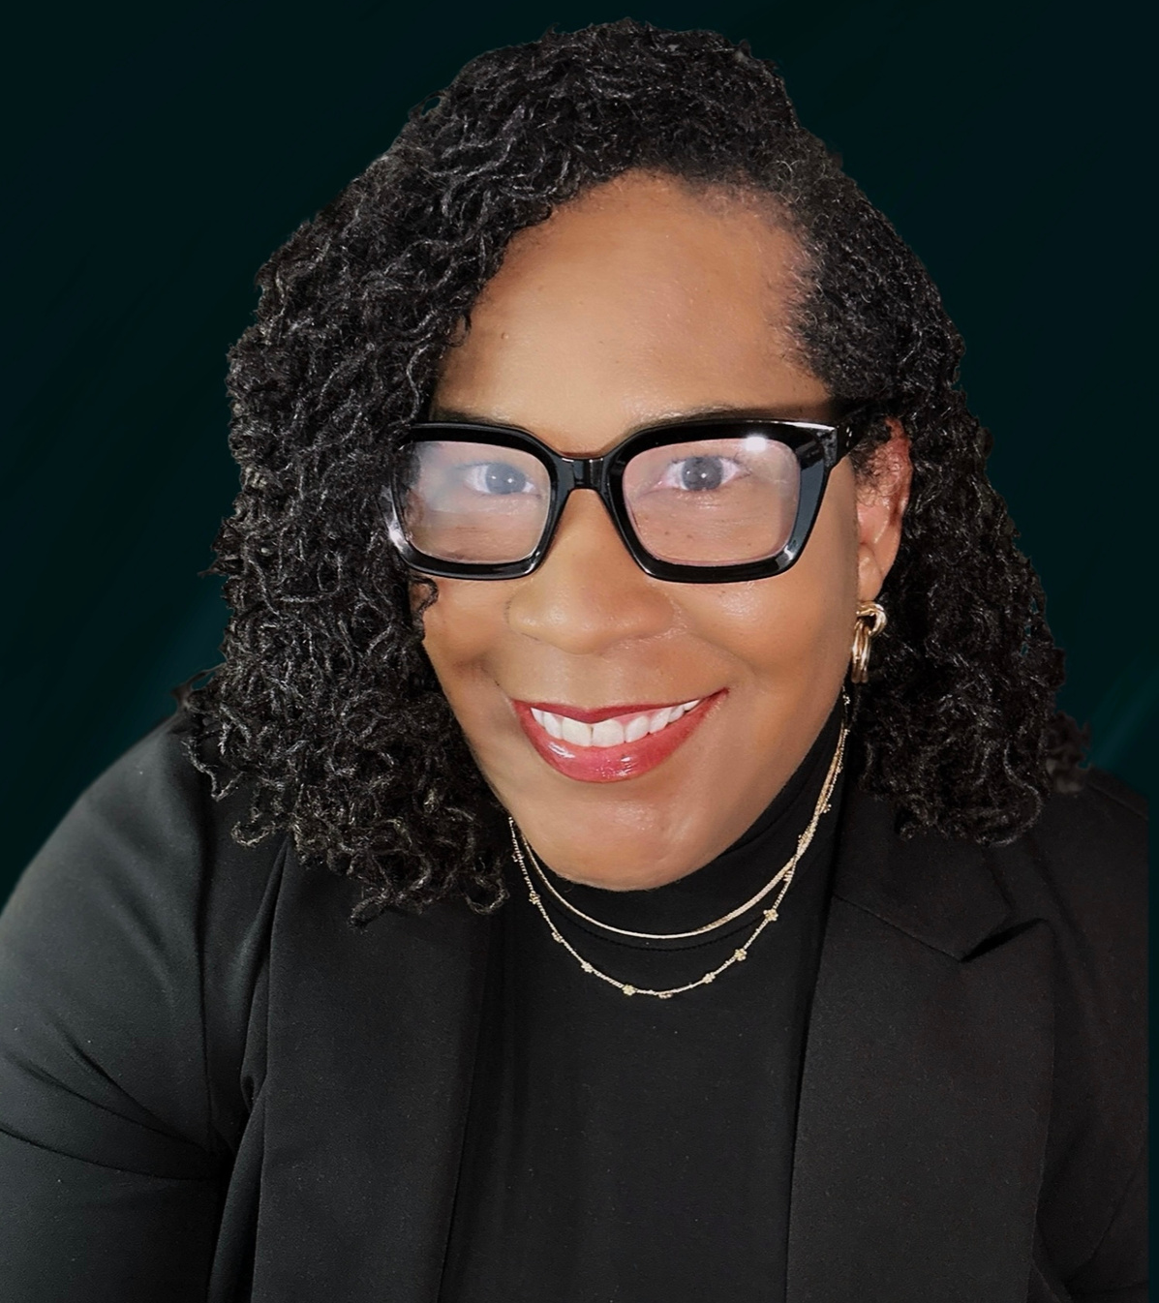
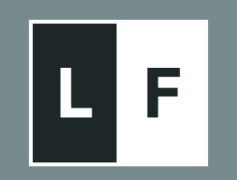
SKILLS
Python
AI/ML
Data Scrapping
Prompt Engineering
LLMs
Text Extraction
Document Intelligence
Python Automation
Optical Character Recognition (OCR)
Retrieval-Augumented Generation (RAG)
Helping businesses improve, automate, and architect critical tasks (such as document handling, customer service, and data management) by saving thousands of hours and boosting accuracy.

Slide 3
SPRINTS
Mortgage Documents
2025
AI Document Intelligence
Python & Google Colab
Python Data Extraction
Optimizing OCR
Implementing RAG
Optimizing RAG Pipelines
Blob Processing & Classification
Interactive Chatbot
AI-Powered Document Automation Platform
01
02
03
04
05
06
07
08
09
PROJECT TIMELINE
10 WEEKS

Slide 4
01
AI Document Intelligence
Extracting Key Insights from Mortgage Files

Slide 5
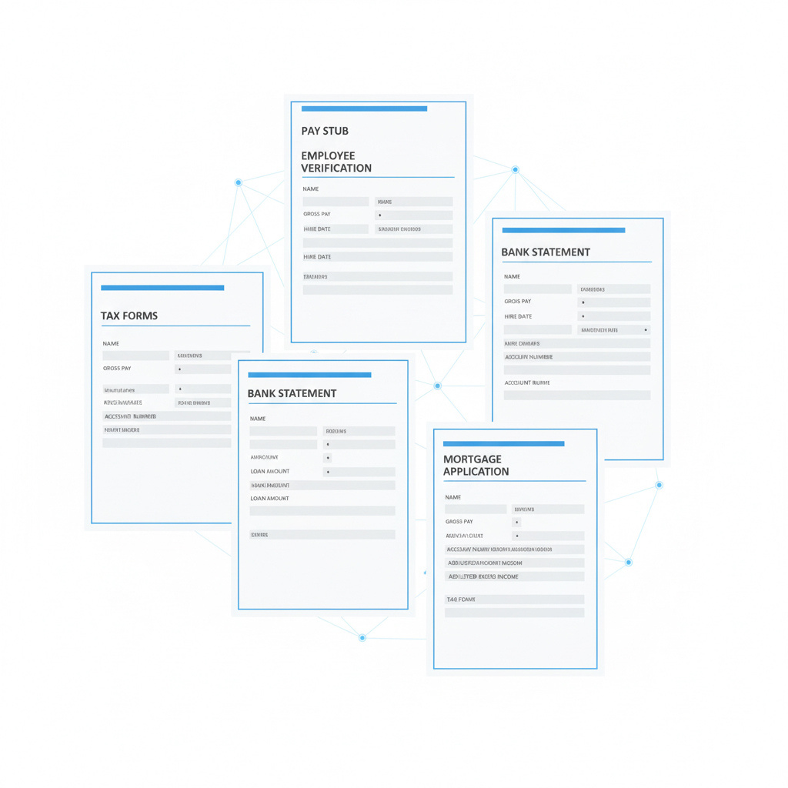

Background: 10-Week Project
The Outamation Advanced AI-Powered Document Insights and Data Extraction Externship is a comprehensive 10-week program. Its core goal and purpose is to master the required skills to create an AI-Powered Documentation Automation Platform. The program focuses on bridging foundational technologies (ML, LLMs, NLP, Computer Vision) with high-value industry applications, such as solving complex, document-heavy challenges in mortgage automation, ultimately transforming slow, manual review processes into automated, efficient workflows.

Slide 6

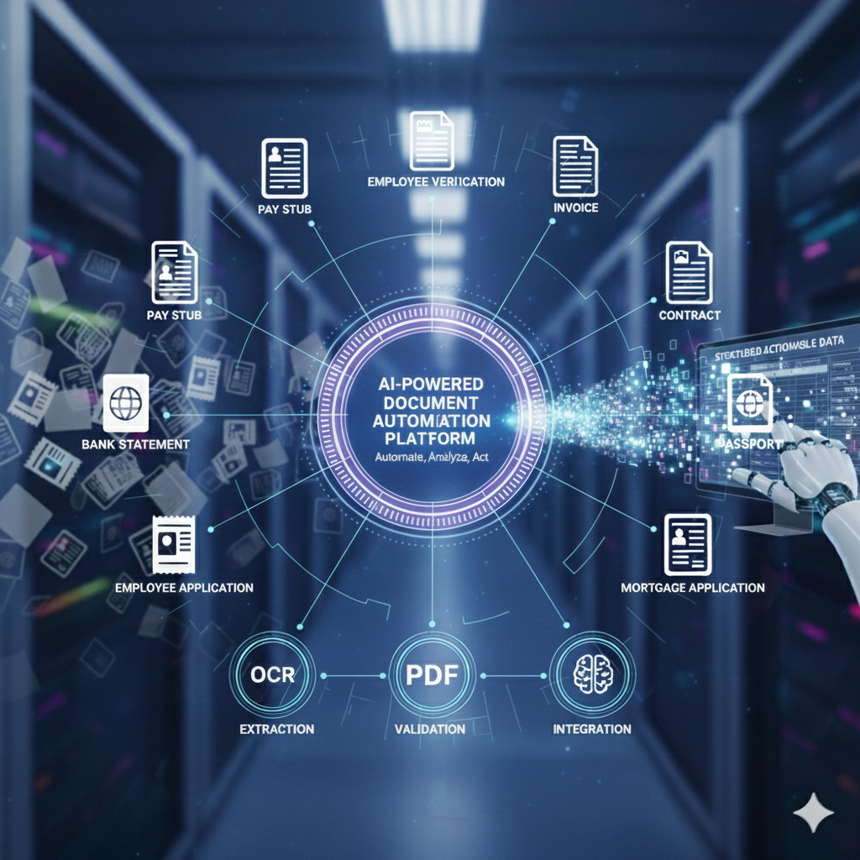
Overall Status: Sprint 1 Complete
I have successfully concluded Sprint 1 focused on Advanced AI-Powered Document Insights and Data Extraction. The primary goal of this sprint was to establish both the theoretical foundation and the practical application of AI in document automation. I progressed seamlessly from mastering core AI concepts, such as LLMs and Generative AI, to implementing industry-grade tools. I am now fully prepared to apply this end-to-end document intelligence pipeline to solve real-world business challenges.

Slide 7
Key Accomplishments
My key achievements center on validating the full document-to-data workflow:
Integrated Tech Stack Mastery
I mastered the critical steps of converting document visuals into meaningful data, combining Computer Vision (CV) and OCR for digitization with Natural Language Processing (NLP) for deep textual comprehension.
Hands-on Tool Execution
I gained practical experience by successfully utilizing powerful platforms, including Google's Document AI, to perform high-accuracy, real-time Document Classification and Data Extraction from complex, unstructured files.
Business Context
I applied these learnings directly to Mortgage Automation, defining how AI accelerates loan processing and minimizes human error, providing tangible business value through speed and precision.

Slide 8
Key Metrics & Progress
This sprint resulted in measurable progress in both technical and soft skill development:
Technical Proficiency
Achieved validation of my ability to convert diverse documents into structured, usable data using a top-tier tool (Google Document AI).
Process Improvement
I identified critical inefficiencies in manual review, positioning me to help implement solutions that can shift document processing time from weeks to minutes.
Skill Level Up
The exercise significantly improved my Attention to Detail and Critical Thinking, which are essential skills for performing crucial tasks like Anomaly Detection and fraud prevention across large, complex document packages.

Slide 9

THANK YOU
https://github.com/LashawnFofung/AI-Powered-Document-Automation-Platform

